Slide 1
Web Design & Development
Industrial Attachment

Slide 2
Title and Content Layout with List
Concept of Web Design and Development.
Materials.
Element.
Create a website using only table element of HTML (project-1).
Create a Carom Board using HTML & CSS.
Design a Website only using HTML & CSS.
Create a Website like Bangladesh.gov.bd using (HTML, CSS, Bootstrap).
Develop dynamic Website like Bangladesh.gov.bd

Slide 3
Web Design and Development
Web design and development is an umbrella term that describes the process of creating a website. Like the name suggests, it involves two major skill sets: web design and web development. Web design determines the look and feel of a website, while web development determines how it functions.

Slide 4
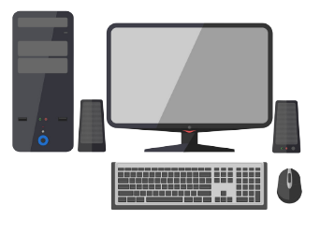

Materials:
Computer,
Keyboard,
Mouse,
Internet,
Essential Software,
Multi-media,
Projector

Slide 5
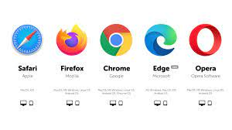
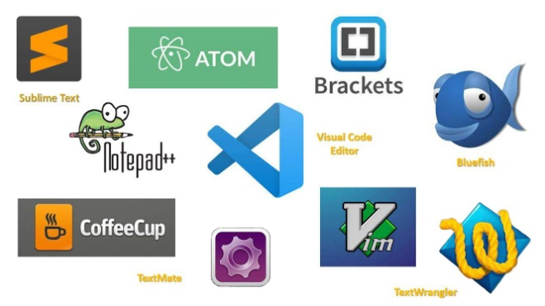
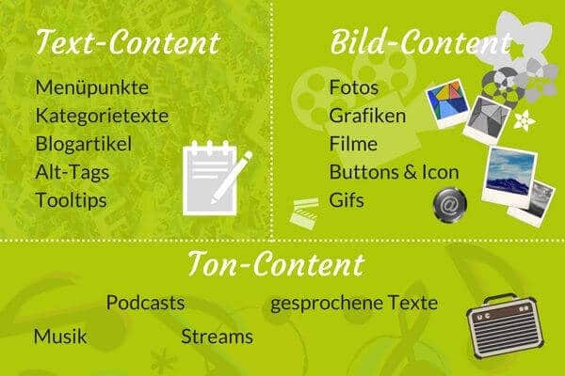
Element:
Browser
Code Editor
Content

Slide 6
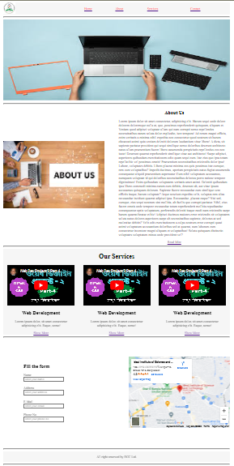
Create a website using only table element of HTML (project-1).

Slide 7
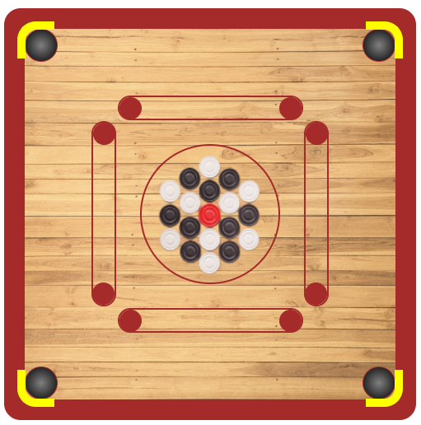
Create a Carom Board using HTML & CSS.

Slide 8
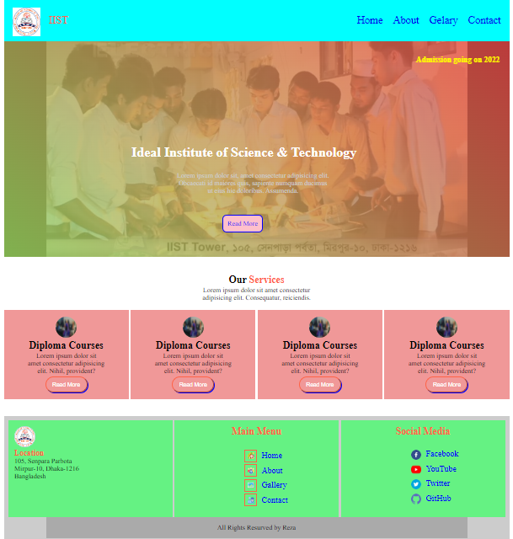
Design a Website only using HTML & CSS.

Slide 9
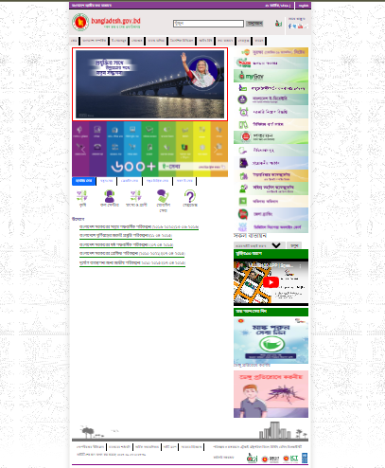
Create a Website like Bangladesh.gov.bd using (HTML, CSS, Bootstrap).

Slide 10
Develop dynamic Website like Bangladesh.gov.bd

